Slide 1
Benefits Open Enrollment Instructions
eSELFSERVE.COM

Slide 2
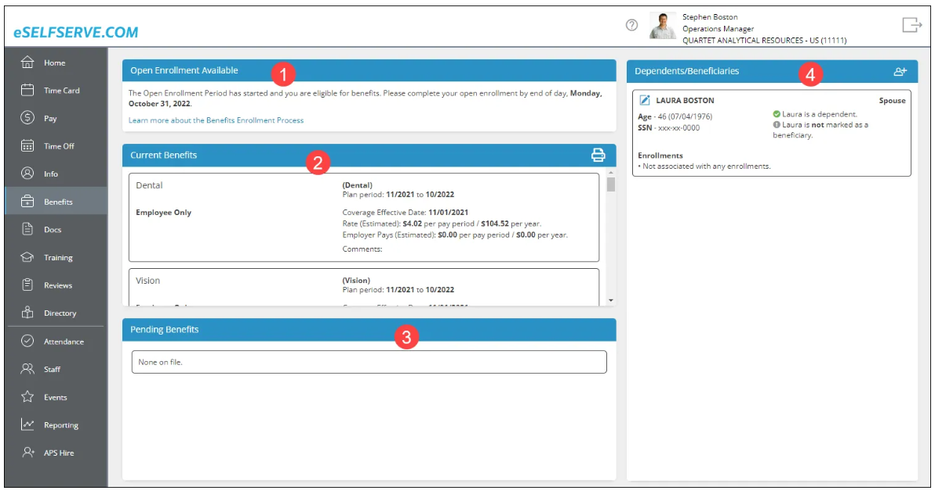
Enrollment Overview
____________________________________________________________________________________________
During open enrollment, an Open Enrollment panel will notify you to enroll in benefits.
An alert will also be displayed in the Alerts panel of the Home dashboard.
Clicking the Home dashboard alert or the Open Enrollment panel in the Benefits tab will take the employee to enroll in benefits.
View current benefits.
See which benefits await HR approval.
Edit dependents/beneficiaries with the pen and pad icon and add dependent/beneficiary with the person/+ icon.
Click your Home dashboard alert or the Open Enrollment panel in the Benefits dashboard to begin the benefits enrollment process.

Slide 3
Step 1 – Welcome to open Enrollment
____________________________________________________________________________________________
Click your Home dashboard alert or the Open Enrollment panel in the Benefits dashboard to begin the benefits enrollment process.
Instructions will be displayed here. Read and continue with Let’s Get Started >.

Slide 4
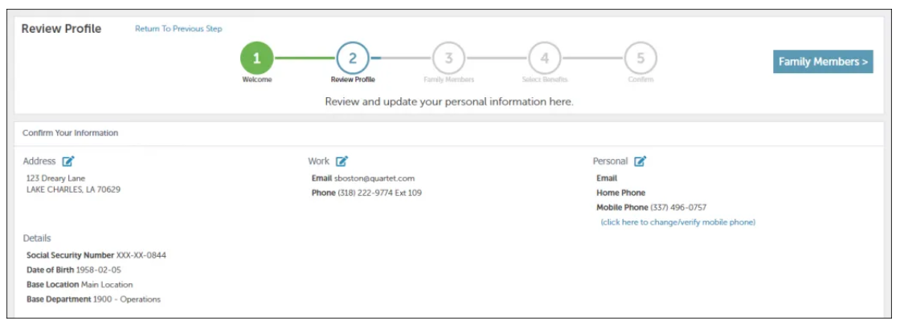
Step 2 – Review Profile
____________________________________________________________________________________________
Review and edit current employee demographic information in Step 2. Click the pencil icon to edit information. Once you are finished, select the “Family Members” icon to go to next page

Slide 5
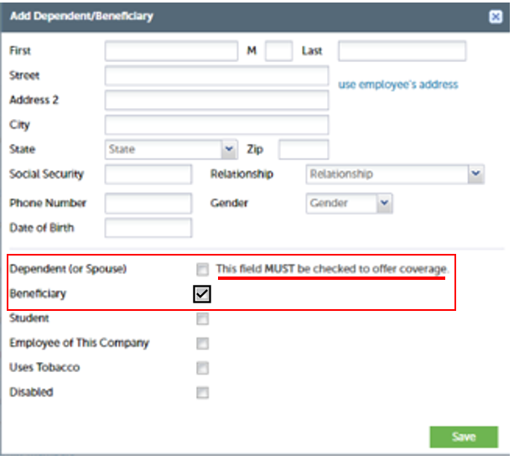
Step 3 – Family Members
____________________________________________________________________________________________
It is IMPORTANT that you add yourself AND all of your family/dependents to your profile even if you are not covering them or are waiving your benefits options.
Add or update any dependents and beneficiaries then choose Select Benefits > to continue to coverage selection.

Slide 6
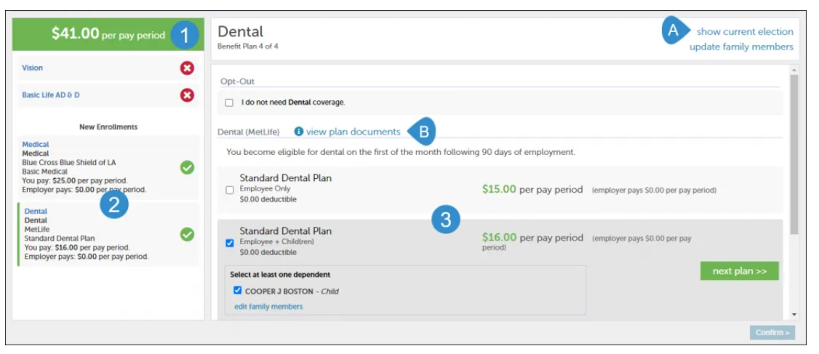
Step 4 – Select Benefits
____________________________________________________________________________________________
As benefits are elected, the total cost will be added and shown.
To compare with what you currently pay, choose the show current election link.
Select the plan for enrollment and then the coverage options desired. When enrollment for that plan has been completed, a green check will appear next to that plan.
Be sure to read any plan documents provided for review if needed.
Check the box next to the plan option you want. If the selected option includes dependents, they will be able to check applicable dependents.
If you are not interested in enrolling in a particular benefit, click on the “I do not want coverage” box.
Once you have finished, select the “Confirm” icon to go to the next page.

Slide 7
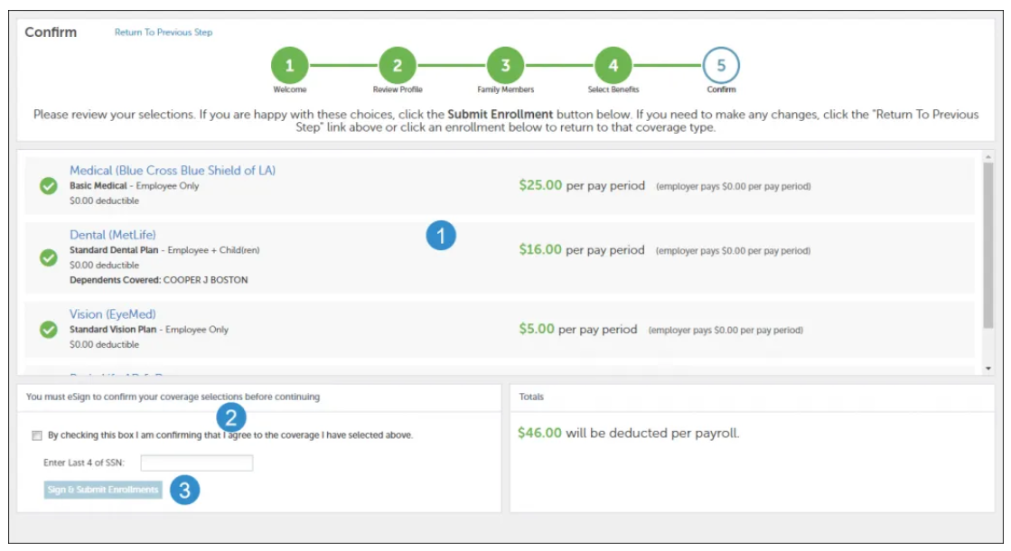
Step 5 – Confirm
____________________________________________________________________________________________
If you need to make changes, choose the plan, make your changes and resubmit.
When you are satisfied with your enrollments, select the checkbox and electronically sign to confirm that you agree to the selected coverage.
Choose Sign & Submit Enrollments.
Once reviewed, you will e-sign to complete the confirmation process.
Select the confirmation box and enter the last four digits of your Social Security Number.
Your Confirmation Statement (whether Pending or Current) will appear in the Employee Documents and eSignature will be requested.

Slide 8
IMPORTANT REMINDERS!
Before getting started, please review your Beneficiary information. Be sure to add yourself and all your family members as dependents and/or beneficiaries . Once you are confident that your information is correct, click the next button to start the enrollment process.
For benefits you do not want you must select opt-out and then go to the next benefit.
At the end of the process, you will be asked to electronically sign indicating that you agree with the benefits you selected.
You cannot elect voluntary life or critical illness for your spouse or child if you do not elect the benefit coverage for yourself.
Voluntary Life:
Employee Life: You can elect up to 5X your annual salary or up to the Guarantee Issue of $150,000; any amount elected above the GI and/or any future increase requires you to complete an EOI.
Spouse Life: You can elect up to 100% of the employee's volume up to $50,000; any amount elected above this requires you to complete an EOI.
Child Life: You can purchase a $10,000 Voluntary Life coverage for your child(ren). No EOI is required for child life coverage.

Slide 9
IMPORTANT REMINDERS!
Critical Illness:
Employee: The Guarantee Issue for employees is $30,000; you can increase coverage by $5,000; the maximum coverage amount is $50,000.
Spouse: The Guarantee Issue for employees is $25,000; you can increase coverage by $1,000 each enrollment; the maximum coverage amount is $25,000.
Child: The Guarantee Issue for employees is $13,000; the maximum coverage amount is 25% of employee coverage up to $13,000.
REMEMBER: Newly elected Critical Illness or Voluntary Life coverage for employees or spouses, or electing coverage higher than allowed limits requires you to complete an EOI. This form is available upon request in the HR Office.
EOI form can also be located at www.mutualofomaha.com/eoi

Slide 10
IMPORTANT REMINDERS!
Health Savings Account (HSA) and Flexible Savings Accounts (FSA)
You can elect to participate in the HSA plan only if you are also enrolled in Option 2: HDHP medical plan.
You can elect to participate in the FSA plan regardless of which medical plan you elect and even if you elect to not participate in the College medical plan. However, you cannot elect an HSA and FSA- Medical for the same plan year.
If you are electing the HSA or FSA plan(s) you must complete a separate enrollment form. These forms are attached to the benefit election and are available upon request in the HR Office.
Company Paid Benefits
The following benefits are paid for you by the college; however, you MUST elect these during open enrollment.
Basic Life
Basic Dependent Life - for your spouse or child, where applicable
Long Term Disability

