Slide 1
Manager eSelfServe Mobile The Mobile App that allows Managers access to essential team information, tasks on the go, and alerts them to any items that may require their attention, allowing Managers to manage time and labor efficiently on the go.

Slide 2
Assistance Requests
PAYROLL & TIME MANAGEMENT
Please direct all pay-related and time-reporting issues/questions to:
Linda Montgomery, Payroll Coordinator
lmontgomery@centenary.edu
(318) 869-5127
HUMAN RESOURCES
Please direct all personnel issues/questions to:
Patrica Netherton, Director of Human Resources
pnetherton@centenary.edu
(318) 869-5191
Debra Jackson, Human Resources Assistant
dhalljackson@centenary.edu
(318) 869-5077

Slide 3
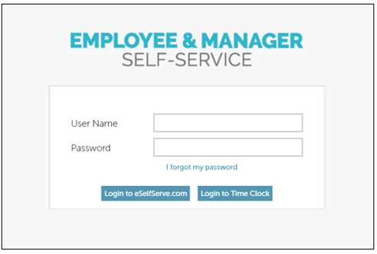
User Login
If you have never accessed eSELFSERVE.COM before, your default password will be the last four digits of your Social Security number.

Slide 4
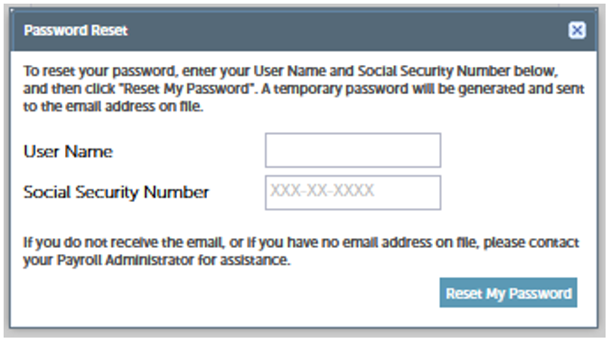
Password Reset
If you have forgotten your password, simply click on the “I forgot my password.”
To reset your password, enter your Username and Social Security Number below, and then click "Reset My Password". A temporary password will be generated and sent to the email address on file.

Slide 5
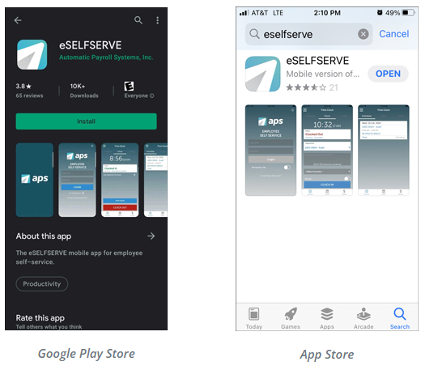
Downloading the App
The mobile app is available to authorized customers of APS with an iOS or Android device. Open the App Store or Google Play Store and type “eSelfServe Mobile" in the search bar.
If you have trouble locating the app in your selected App Store, you can visit one of the following links to download:
Android: https://play.google.com/store/apps/details?id=com.apspayroll.essmobile
Apple: https://itunes.apple.com/us/app/eselfserve-mobile/id1377718614?ls=1&mt=8

Slide 6
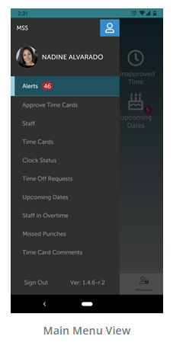
Main Menu
The Main Menu displays various points to access within the mobile app. Items visible here may vary by individual and are based on assigned permissions established in eSelfServe.
At any time, a manager can tap the blue icon in the top right-hand corner of the screen to switch to Employee self-service (ESS) mode to access their personal eSelfServe profile.
From the main Manager Self-Service (MSS) mobile menu, managers can navigate to:
Alerts
Approve Timecards
Staff
Timecards
Clock Status
Time Off Requests
Upcoming Dates
Staff In Overtime
Missed Punches
Timecard Comments

Slide 7
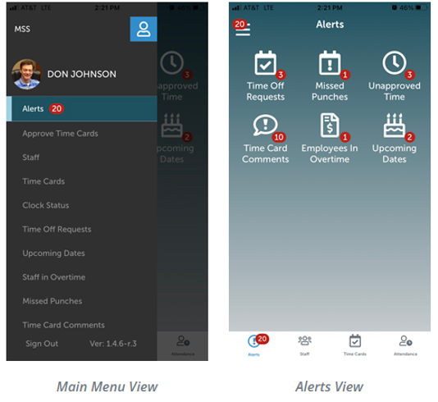
Alerts
Managers can instantly view what tasks to complete to take action in the Alerts tab.
Alerts are indicated by a displayed white number within a red circle (aka "hamburger alert"). Once selected, users are taken to the Alerts page, and are able to view various items in the app that require their attention:
Time Off Requests
Missed Punches
Unapproved Time
Timecard Comments
Employees in Overtime
Upcoming Dates (Birthdays, Employee Anniversaries, Day Offs)

Slide 8
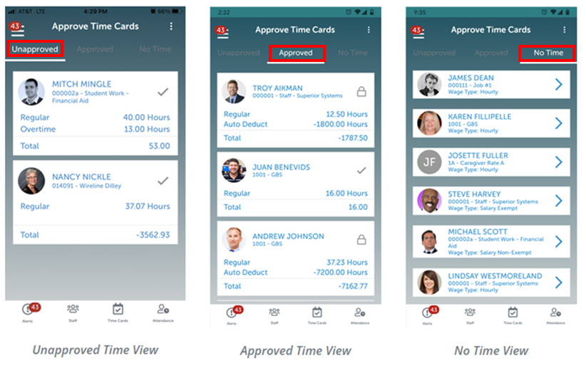
Approve Timecards
The Approve Timecards option allows Managers to view Approved and Unapproved Timecards as well as employees with no logged time. If permission has been given to the Manager during the setup process, they may also submit time on behalf of their teams.
Select the Approve Timecards option from the Main Menu or tap the alert from the Dashboard. From the Timecard list:
Unapproved: Tap the timecards to approve.
A green check mark will indicate that you have selected the timecard for approval.
Approved: To view Approved Timecards, select the Approved tab.
Any unread employee comments on timecards must be read before a timecard can be approved.
To edit a timecard from this screen, tap the time desired (Regular, Overtime, etc.).
No Time: Employees with no time logged will be displayed on this tab.

Slide 9
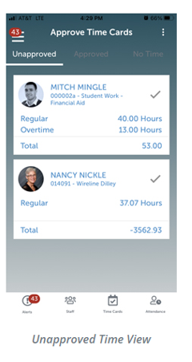
Timecards – Unapproved
Unapproved Time
Managers can tap the checkmark next to each employee’s unapproved timecard. From there, they can scroll to the bottom of the screen and select the “Approve X Timecard Button. ” This allows managers to approve timecards in bulk, eliminating redundant tasks.
Note: If a manager needs to make changes or have their employee make changes to their timecard, it will need to be unapproved.
Managers simply need to enter the last four digits of their Social Security Number and select a checkbox to confirm their information’s accuracy. From there, they can submit the approval.

Slide 10
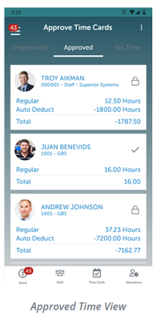
Timecards - Approved
Approved Time
Here, managers can tap the checkmark next to the employee's name and then select the “Unapprove X Timecard(s)” button. Tapping this will send the approved Timecards back to the Unapproved section, where managers can make additional changes.

Slide 11
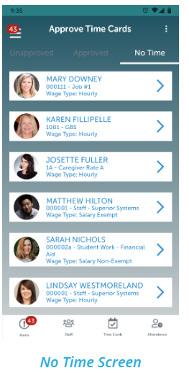
Timecards – No Time
No Time
This screen displays a list of part-time employees who have not logged time to their timecards for the current pay period. Tapping on the employee record will show the Timecard Edit screen for the current employee’s pay period. This visibility will help managers ensure time is properly logged for employees and identify any potential productivity issues.
This functionality eliminates errors from paper timesheets and maximizes managers’ time and efficiency on the go.

Slide 12
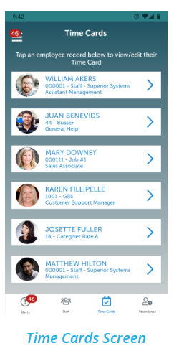
View Timecards Instantly
Managers can view their employees’ timecards for the current pay period to see the time worked. They can also modify a timecard for the current pay period before submitting it. This review and approval functionality allows managers to quickly edit timecards without using a computer to move on with their day.
Managers can also navigate through previous pay periods and view timecard details.
Timecard views include:
The total hours worked, including regular and additional time.
Details for days, shifts, and any additional hours added to employee timecards.
Managers will also receive an alert if they try to approve a timecard with outstanding issues, such as a missed punch. By tapping the alert icon, they can review the reason the timecard cannot be approved. Managers will then choose either View Timecard, View Time Off, or select OK to leave the issue unresolved. Once the issue has been resolved, a gray checkmark icon will appear, letting the manager know the timecard is ready to approve. Managers can also navigate through previous pay periods and view timecard details.

Slide 13
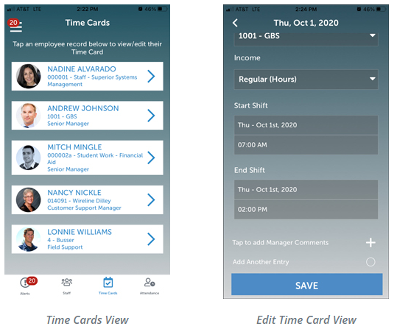
View/Edit Timecards
Select the Timecards option from the Main Menu.
Tap the desired employee record to view/edit that employee's Time Card.
Or go to the Approved Timecards screen, tap the desired timecard you wish to edit.

Slide 14
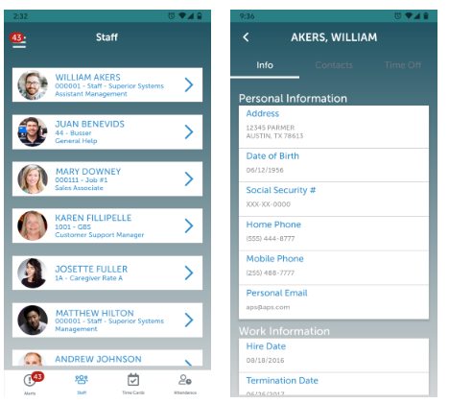
Staff
Managers have quick access to essential employee record information. This transparency allows managers to stay more connected with their employees and ensure a collaborative work relationship. Accessing the Staff section of MSS will provide users a list of their employees.
Managers can access the following information by tapping on a specific employee:
Info: Personal demographic information, such as address and phone numbers, and employee details such as hire date and base department.
Contacts: Emergency contact information, including phone numbers.
Time Off: Unapproved and approved time-off requests, as well as accrual balances

Slide 15
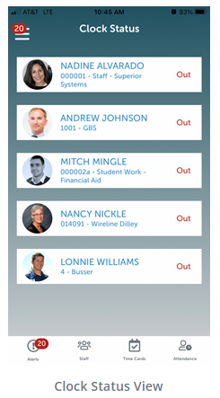
Clock Status
The Clock Status screen provides an overview of employee statuses. An employee list will display the following:
“Out” for employees clocked out
“In” for employees clocked in
“Break” for employees on break
“Lunch” for employees at lunch
Clicking on an employee will display their shift, if applicable. Managers can instantly assess what is going on with their employees throughout the day. This visibility places managers on the frontline of accountability.

Slide 16
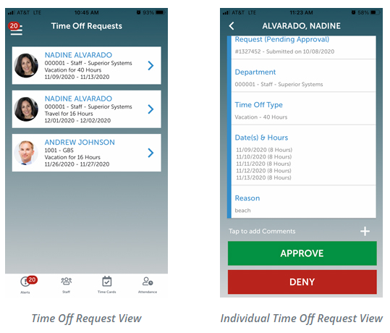
Time Off Request
Managers can quickly review all current time-off requests on the go and approve or deny them from the mobile app. By tapping on the employee record, they can access details of the time-off request, including:
Request
Department
Time Off Type
Date(s) and Hours
Reason
Managers can also add comments to a time-off request, if necessary. This functionality makes it easier to manage time-off requests from any location to streamline this essential process.
Tap the employee record the view more details.
Tap the ( + ) sign to add Comments
Tap APPROVE to approve or DENY to deny the request.

Slide 17
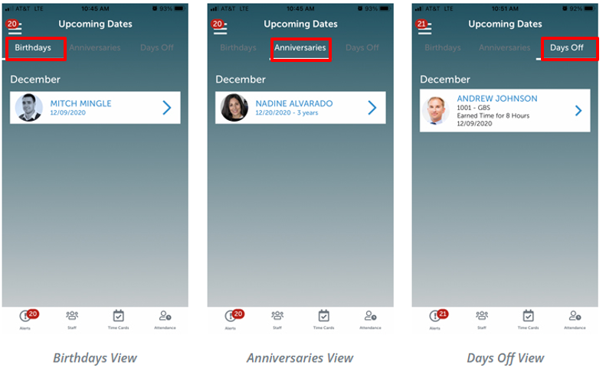
Upcoming Dates
By selecting the Upcoming Dates tab, managers can also utilize MSS mobile to view important dates such as:
Birthdays
Anniversaries
Time Off
Leaders can keep employees engaged and promote a positive work culture when they are aware of important information.

Slide 18
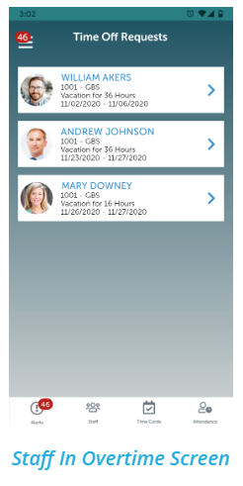
Staff in Overtime
This tab lets managers view a list of employees approaching or in overtime. This feature is especially useful because it helps leaders stay on track with labor costs.
Note: Managers can access Alerts, Staff lists, or Timecards at any time using the navigation menu on the bottom of the screen.

Slide 19
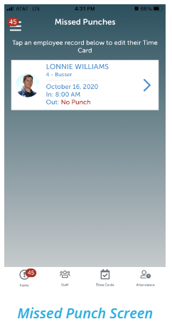
Missed Punches
Managers can view employee missed punches by tapping from either the Alerts menu or the main mobile menu. From there, managers can see a list of employees who have missed punches for recorded shifts.
Users can tap on a Missed Punch Record and navigate to the shift details for the missed punch.
Managers can leave the shift as is, update the shift with the proper start or end times, or delete the shift entirely.

Slide 20
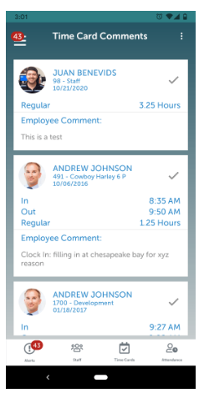
Timecard Comments
Managers can open alerts and view comments employees leave on their timecards. They can take action on the comments and mark them as Read. Marking a timecard comment as Read will remove the alert from the manager’s list.
This visibility to timecard comments promotes better communication between managers and employees. Managers can also make adjustments to timecards upon receipt of the alert for more proactive labor management.

